Slide 1

MultiCloud Network Architecture
MCNA

Slide 2
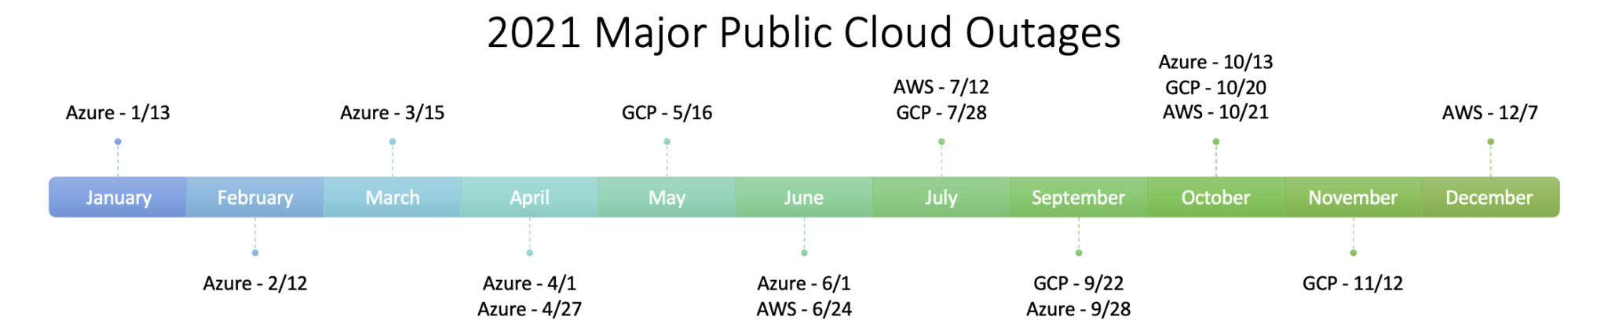
Multicloud Networking is a Must
Gartner
“As organizations add new applications and scale existing ones into the public cloud, the shortcomings of the native cloud providers’ become more apparent.”
“Don’t “forklift” traditional networking strategies into the public cloud.”
Forrester
“Multicloud Is Hard, But Single-Cloud Failures Make It Necessary For Enterprises.”²
Aviatrix
“You’re only in a single cloud until you’re multicloud.”
https://www.sdxcentral.com/articles/news/dell-hybrid-cloud-long-gone-multi-cloud-next-phase/2021/10/
https://www.gartner.com/en/documents/4001639/market-guide-for-cloud-networking-software
https://www.forrester.com/blogs/multicloud-is-hard-but-single-cloud-failures-make-it-necessary-for-enterprises/

Slide 3

Cloud Adoption Gap
Architectural
Gap and Limitation
Enterprise Data Center Networking
Cloud is New Data Center
Enterprise-Class Multi-Cloud Networking and Security
Basic Cloud Networking
Evolution of
Networking
Virtual
Virtual
No
Customer
Access
Virtual
Physical
Physical
Physical
Physical
On-Premise
Private Cloud
Public Cloud

Slide 4






Cloud Network Reference Architecture
ANY CLOUD
Single Cloud, Multi-Region, Multi-Account
Repeatable Network Design and Infrastructure as Code Automation
Service Insertion and Chaining
Consistent Security Policy
Common Operational Visibility and Control
REGION
REGION
REGION
VNets
VNets
VNets
VNets
VNets
VNets
APPLICATION LAYER
App
App
App
App
App
App
App
App
App
App
App
App
App
App
App
App
App
App
App
App
App
App
App
App
SECURITY
CLOUD NETWORKING
OPERATIONS
Transit Core BackBone Layer
ACCESS LAYER
CLOUD NETWORKING
BRANCH
OFFICES
ON-PREM
DATA CENTER
Vendors/Partners
REMOTE
USER
INTERNET
EDGE/ IoT

Slide 5
Multicloud Network Architecture (MCNA)
The Blueprint of Your Multicloud Network Design
ANY CLOUD
Multicloud, Multi-Region, Multi-Account
Repeatable Network Design and Infrastructure as Code Automation
Service Insertion and Chaining
Consistent Security Policy
Common Operational Visibility and Control
REGION
REGION
REGION
REGION
REGION
REGION
VPCs
VPCs
VNet
VNets
VPCs
VPCs
App
App
App
App
App
App
App
App
App
App
App
App
App
App
App
App
App
App
App
App
App
App
App
App
SECURITY
OPERATIONS
CLOUD NETWORKING
BRANCH
OFFICES
ON-PREM
DATA CENTER
Vendors/Partners
REMOTE
USER
INTERNET
EDGE/IoT

Slide 6
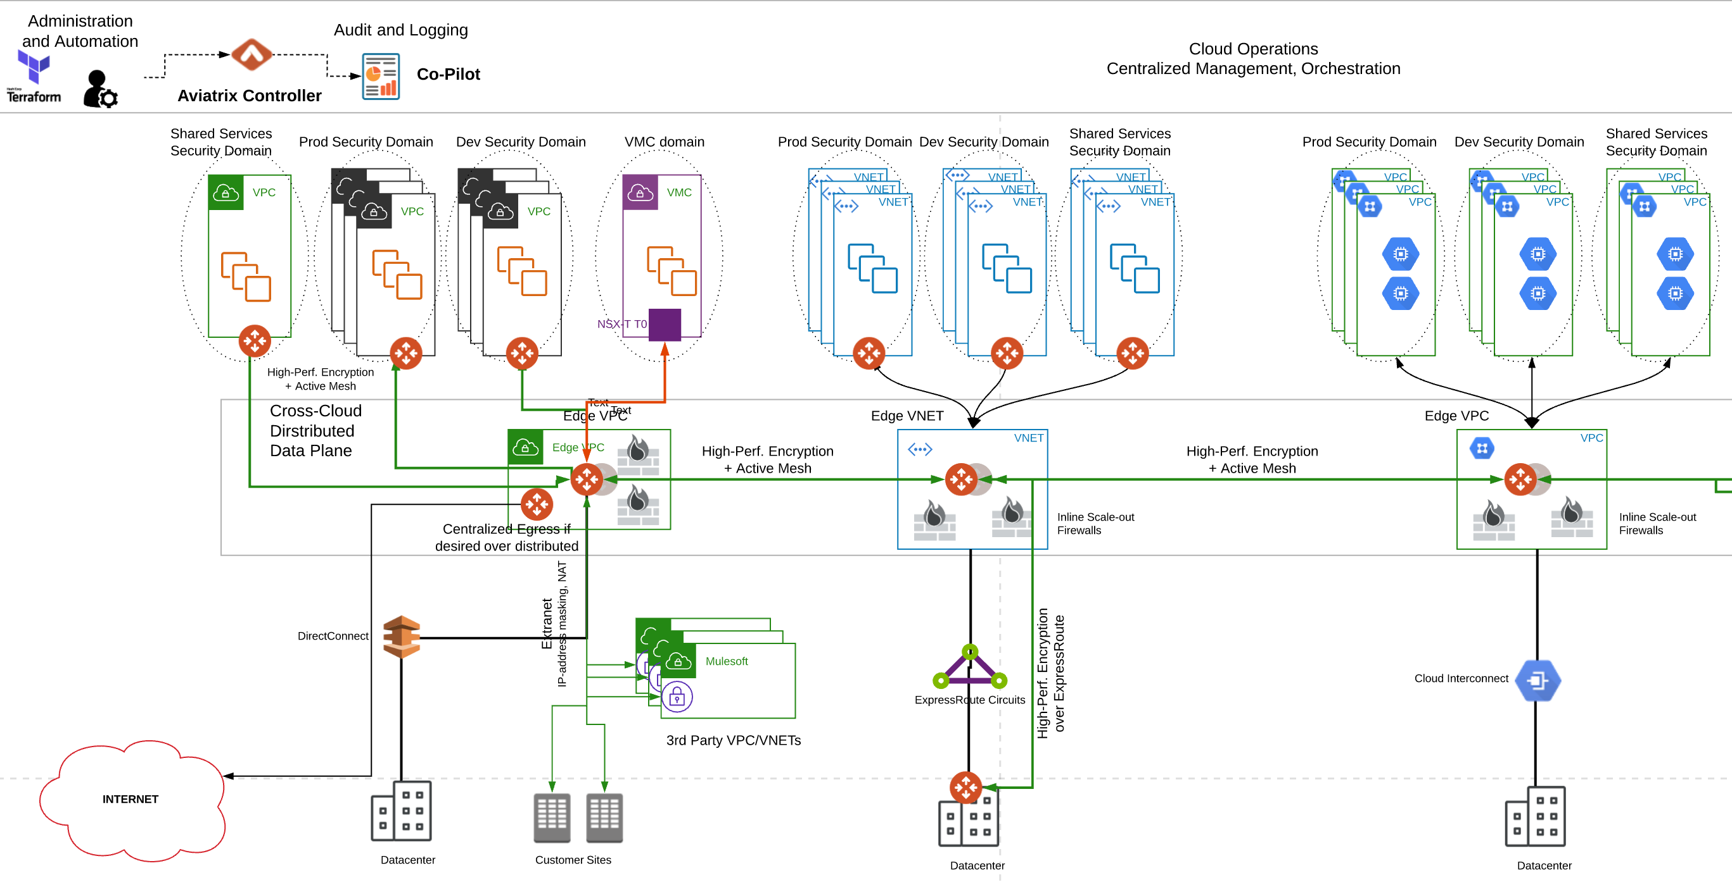

Result: Aviatrix Solution that Meets Design Requirements
Cloud Operations
Automation Packet Capture
Troubleshooting Health Analysis
Capacity Planning Multi-Account support
Orchestration Visibility and Control
Logging Alerting
Flow Analysis Monitoring
Network Segmentation
Distributed Cloud Firewall
End-to-End Encryption
High-Performance Encryption
Distributed Secure Egress
Secure User Access
Secure Site-to-Cloud
DC-to-Cloud Encryption
Transit Core Backbone Layer
Access Routing
Aggregation Routing
Core Routing
L4 FW
NGFW
LB
Internet
Workloads
Storage
SaaS
Vendor Links
Multi-Region
Multi-Cloud
WAN Optimization
Cloud Access Layer
Data Center
Branch
Partner
Users
SD-WAN
MPLS
AWS Direct Connect
Azure ExpressRoute
GCP Cloud Interconnect
Encrypted Access
Internet Backhaul
WAN Optimization
NGFW
Intelligent Edge
5G
IoT
AI Devices
Autonomous Systems
CLOUD ACCESS LAYER NETWORKING

Slide 7
Next: Aviatrix Features Part 1/2

